Slide 1
Jornada Red SAMID Madrid – 11 de Junio 2019
GRUPO RD16/0022/0012
INSTITUTO INVESTIGACIÓN SANITARIA LA FE
HOSPITAL UNIVERSITARIO Y POLITÉCNICO LA FE
VALENCIA

Slide 2
Programa 1. Interventions during pregnancy, neonatal period, and pediatric age for prevention and treatment of conditions influencing adult health. Coordinador: Máximo Vento IIS La Fe, Valencia

Slide 3
Diagrama de flujo programa 1
WP 1: Prenatal risk factors for neonatal
and long-term outcomes
Objetivo 1
WP 2: Neonatal NDI risk factors
Objetivo 2
WP 3: Neonatal nutritional risk factors
Programa 1
WP 4: Postnatal NDI risk factors
Objetivo 3
WP 5: Postnatal nutritional risk factors
Objetivo 4
WP 6: Epigenetic, toxic, environmental
ND & Nutritional risk factors

Slide 4
List of participants

Slide 5
Objetivo 1
To study biomarkers of Intrauterine Growth Retardation, preeclampsia and chorioamnionitis capable of predicting postnatal developmental disorders related to neurocognitive development and nutritional and metabolic status.
ACHIEVABLE RESULTS
a. To establish updated guidelines and protocols for the diagnosis, obstetrical management, and postnatal management of preeclampsia, chorioamnionitis and intrauterine growth retarded (IUGR) neonates and especially prematurity.
b. To study in IUGR neonates the correlation bewteen epidemiological, environmental, socioeconomic, maternal, and fetal hemodynamic factors with neonatal neurocognitive, neurosensorial, nutritional and during infancy.
c. To store biological samples from mothers, umbilical cord, newborn and children in an ad hoc section of the Biobanks of the participating groups to study the biology of chorioamnionitis, preeclampsia and IUGR.

Slide 6
Objetivo 2
To study the efficacy of clinical indicators and biomarkers to early predicting neurocognitive and developmental outcomes and identify risk factors for neurologic sequelae in children after acute neurologic injuries, and to analyze the effectiveness of diagnostic methods and prevention strategies.
ACHIEVABLE RESULTS
a. To establish clinical and biomarkers useful to predict the neurologic evolution of acute neurologic injuries
b. To evaluate the efficacy of diagnostic, prevention and treatment measures in acute neurologic injuries.
c. To develop a Biological Resources Center cohort of acute neurologic injuries
d. To develop a pediatric experimental animal educational program

Slide 7
Objetivo 3
To study neonatal risk factors for adverse nutritional and metabolic outcomes and possible preventive nutritional strategies.
ACHIEVABLE RESULTS
a. To enhance the use of human milk in the NICU using own mother's milk and donated human milk through milk banking.
b. To analyze the quality characteristics of donated human milk after processing (pasteurization).
c. To optimize individual fortification.
d. To study evolving microbiome in preterm infants under different clinical circumstances.

Slide 8
Objetivo 4
To study pre-and-postnatal environmental factors associated with neurologic, nutritional, and metabolic conditions in the perinatal and childhood periods.
ACHIEVABLE RESULTS
A. To determine the prevalence and the exposure of the newborn infant to specific environmental toxics and abuse substances and the exposure.

Slide 9
Programa 1: Workpackages

Slide 10
Programa 1 – Workpackage 1 PRENATAL RISK FACTORS FOR ABNORMAL NEONATAL AND LONG TERM OUTCOME. Objective 1.1. Chorioamnionitis
Description of a new biomarkers able to early identify Intra-amniotic infection using targeted HPLC-MS/MS
Glutathione sulfonamide
Nitro-tyrosine
3-Chloro-tyrosine

Slide 11
Programa 1 – Workpackage 2 NEONATAL RISK FACTORS FOR IMPAIRED NEURODEVELOPMENT OUTCOME. Objective 1

Slide 12
Programa 1 – Workpackage 2 NEONATAL RISK FACTORS FOR IMPAIRED NEURODEVELOPMENT OUTCOME. Objective 1

Slide 13
Programa 1 – Workpackage 2 NEONATAL RISK FACTORS FOR IMPAIRED NEURODEVELOPMENT OUTCOME. Objective 3

Slide 14
Programa 1 – Workpackage 2 NEONATAL RISK FACTORS FOR IMPAIRED NEURODEVELOPMENT OUTCOME. Objective 2,4,6

Slide 15
Programa 1 – Workpackage 2 NEONATAL RISK FACTORS FOR IMPAIRED NEURODEVELOPMENT OUTCOME. Objective 6

Slide 16
Programa 1 – Workpackage 3 NEONATAL RISK FACTORS FOR ADVERSE NUTRITIONAL AND METABOLIC OUTCOME .

Slide 17
Programa 1 – Workpackage 6 EPIGENETIC, TOXIC AND ENVIRONMENTAL RISK FACTORS FOR ABNORMAL DEVELOPMENTAL, NUTRITIONAL AND METABOLIC OUTCOME. Objective 6.1.

Slide 18
Programa 1 – Workpackage 6 EPIGENETIC, TOXIC AND ENVIRONMENTAL RISK FACTORS FOR ABNORMAL DEVELOPMENTAL, NUTRITIONAL AND METABOLIC OUTCOME.

Slide 19
Programa 1 – Workpackage 6 EPIGENETIC, TOXIC AND ENVIRONMENTAL RISK FACTORS FOR ABNORMAL DEVELOPMENTAL, NUTRITIONAL AND METABOLIC OUTCOME. Objectives 6.1, 6.2

Slide 20
Programa 1 – Workpackage 3 NEONATAL RISK FACTORS FOR ADVERSE NUTRITIONAL AND METABOLIC OUTCOME .

Slide 21
Programa 1 – Workpackage 3 NEONATAL RISK FACTORS FOR ADVERSE NUTRITIONAL AND METABOLIC OUTCOME 3.1.1..

Slide 22
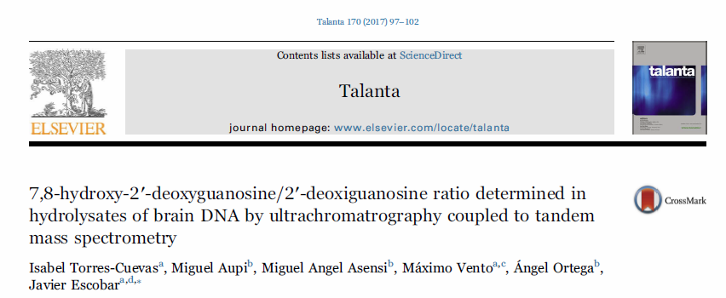
Programa 2 – Workpackage 1 NOVEL PLACENTAL BIOMARKERS FOR THE DIAGNOSIS AND PROGNOSIS OF PRE-ECLAMPSIA Development of analytical methods for complex matrices
Validado los métodos en ratones para genes y transcriptómica
Necesitamos muestras de placentas normales y de pre-eclámpticas.

Slide 23
Expresión genes de defensa antioxidante
Tejido cerebral ratones P7
*<0.05 vs. Nx21/21/21
&&<0.01 Vs Nx21/100/21, &&&<0.001 Vs Nx21/100/21
#<0.05 Vs Hx14/21/21, ##<0.05 Vs Hx14/21/21
Notes:
A la semana la expresión de estos genes aparece aumentada en el grupo Hx14/100/21, la respuesta frente a la reanimación se hace más evidente a más largo plazo activándose mecanismos para proteger al cerebro.

Slide 24
Biomarcadores de EO: Proteínas
Oxidación y nitración proteica tejido cerebral ratones P1
Nacimiento bajo condices hipóxicas produce un menor daño a proteínas
*<0,05 vs. Nx21/21/21
***<0.001 vs. Nx21/21/21
&<0.05 Vs Nx21/100/21
Torres-Cuevas I. et al ACA 2016
Notes:
Para completar el estudio del estrés oxidativo, se determinaron biomarcadores de daño oxidativo y nitrosativo a las proteínas.

Slide 25
Expresión genes: Dianas de HIF-1α
Hipoxia tisular con una FiO₂=0.14
*<0.05 Vs. Nx21/21/21
**<0.01 Vs. Nx21/21/21
&<0.05 Vs Nx21/100/21

Slide 26
Expresión genes: Inflamación
*<0.05 Vs. Nx21/21/21

