Slide 1

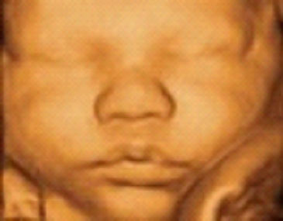
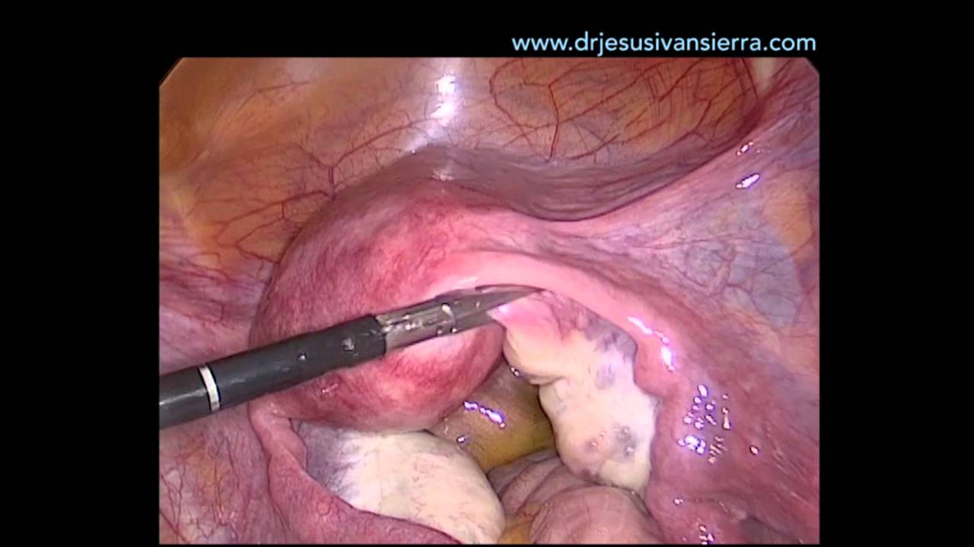
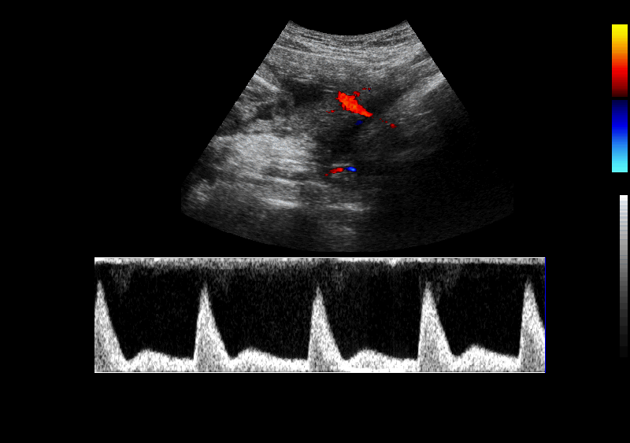
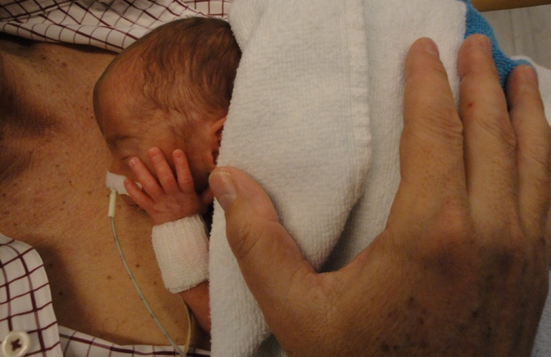
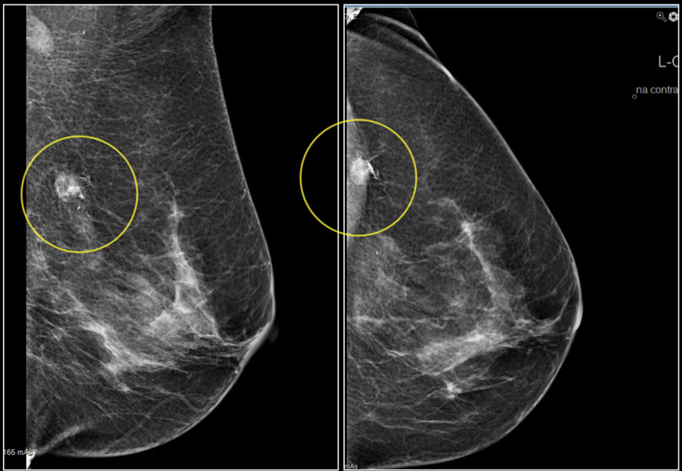

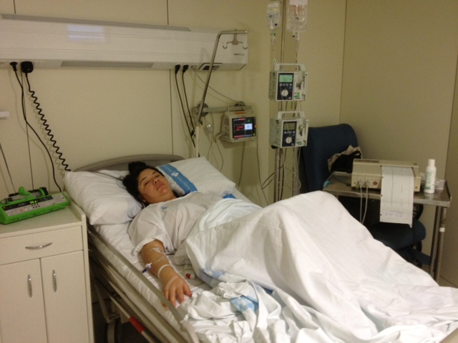
PROGRAMA 2 RED SAMID

Slide 2


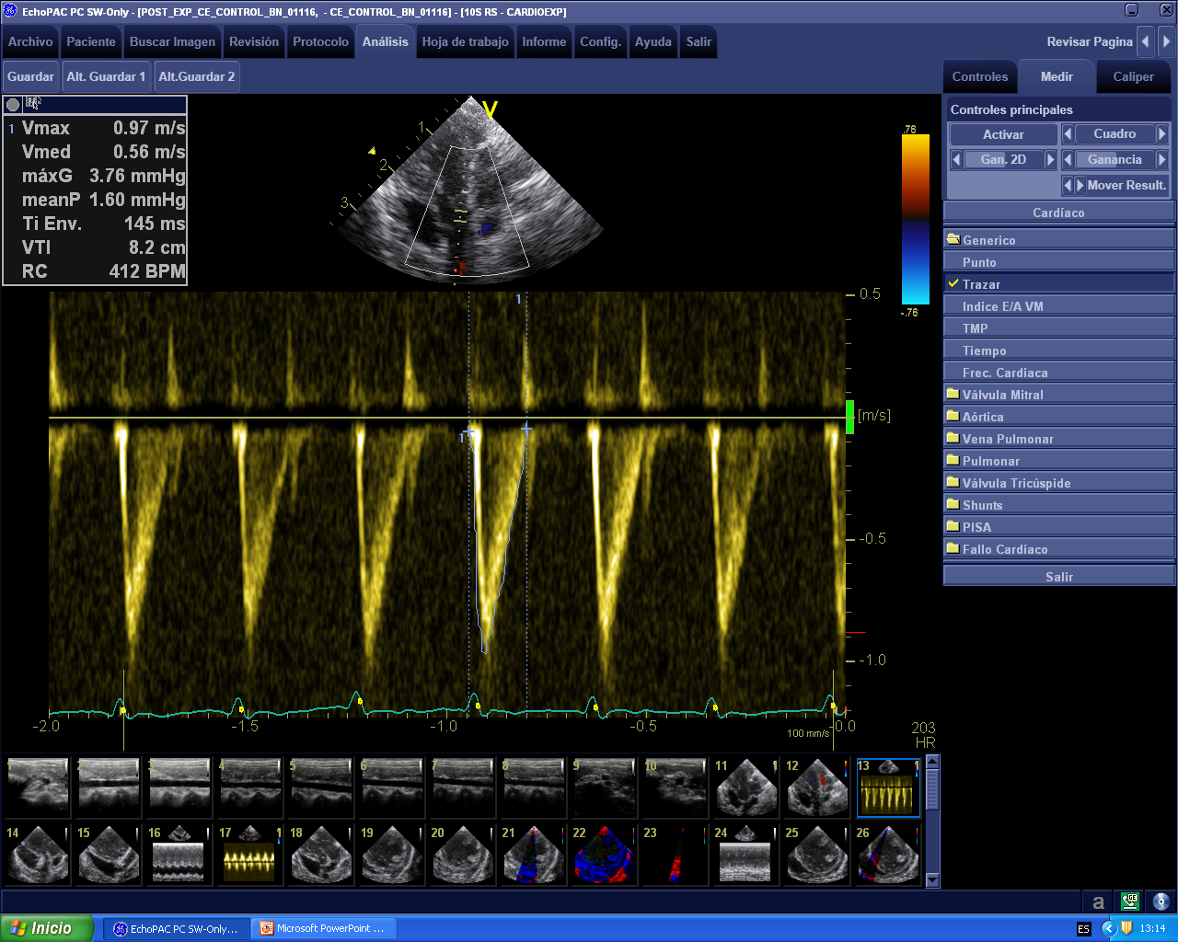
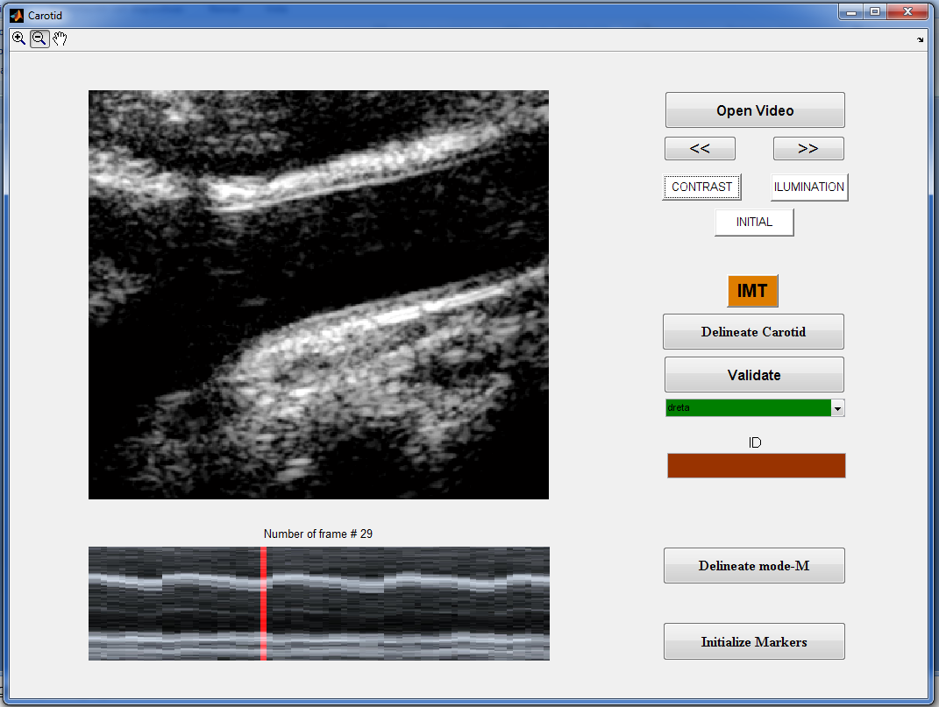
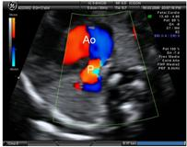
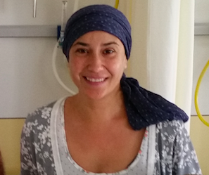
PROGRAMA 2
Programación materna y fetal de las enfermedades cardiovasculares y metabolicas de origen placentario.
RETICS I.S. Carlos III: Red de Salud Materno-Fetal y del Desarrollo RD16/0022/0015
OBJETIVO 1:
Nuevos marcadores CIR/PE
PI17
OBJETIVO 2:
Predicción-Prevención PE/CIR
  PI16
OBJETIVO 3:
Risc CV tardío
OBJETIVO 4:
Cardiopatias cong
PI13/01449
NIH 2017
OBJETIVO 5
Cáncer y gestación
  PI15-col
  PI16-col
Genética
Cardiologia
Neonatologia
Endocrinologia
Medicina Interna
Neurologia pediàtrica
Ginecologia Oncològica
Medicina Materna i Fetal

Slide 3
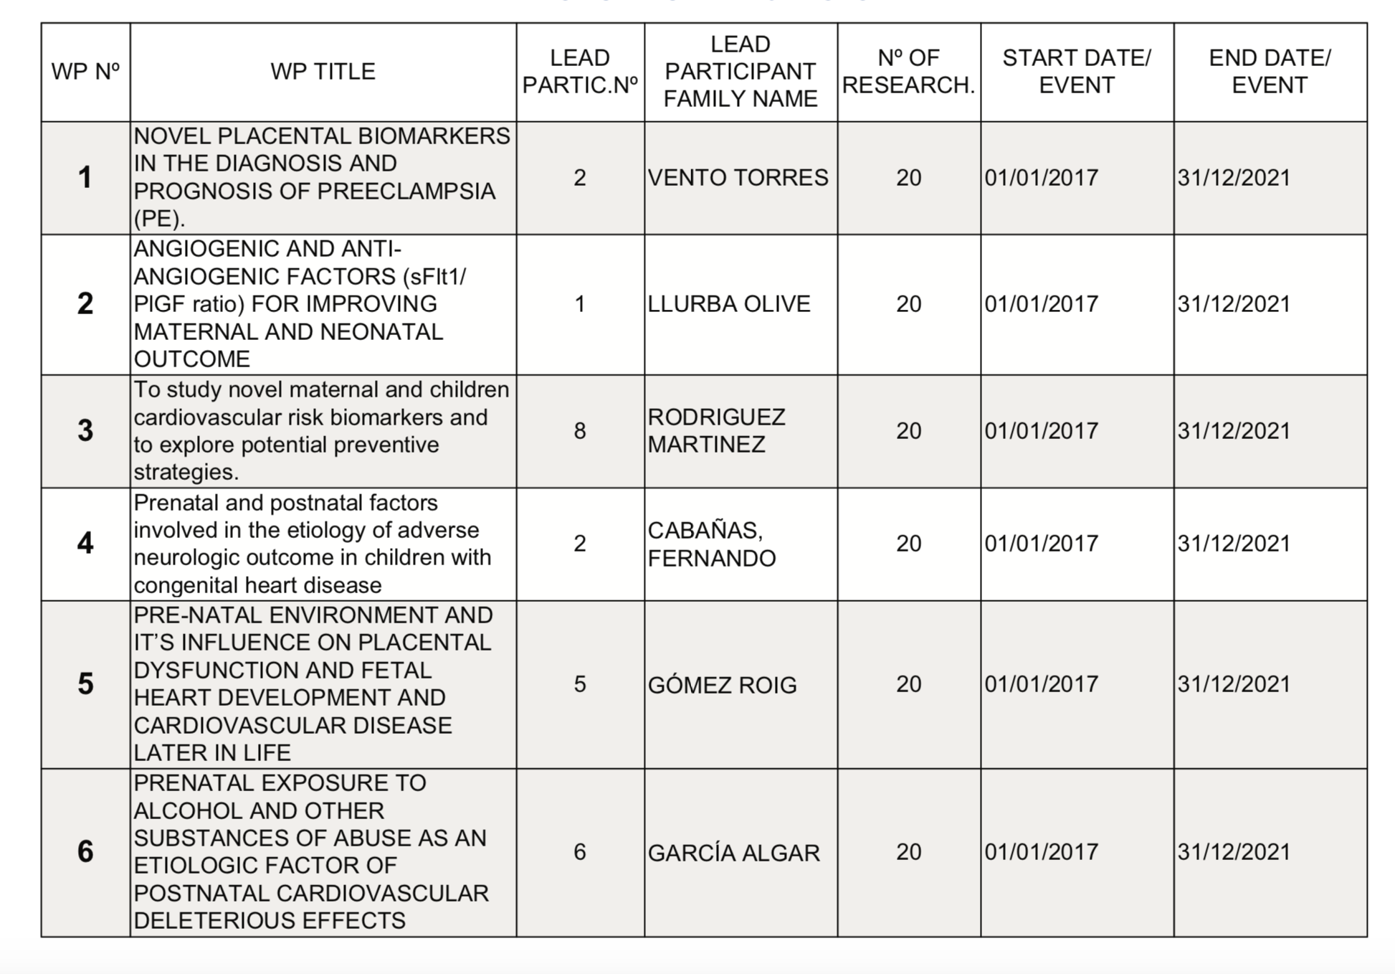
Red de Salud Materno Infantil y del Desarrollo

Slide 4
PROGRAMA 2
Programación materna y fetal de las enfermedades cardiovasculares y metabolicas de origen placentario.
TO STUDY NOVEL PLACENTAL BIOMARKERS IN THE DIAGNOSIS AND PROGNOSIS OF PREECLAMPSIA (PE). (MAX VENTO)
1) To identify the relevance of placental metabolic pathways related to apoptosis, inflammation, oxidative stress and angiogenesis according to the type of PE
2) The identification of pathological pathways contributing to anti-angiogenic status in PE to generate potential therapeutic targets
3) The evaluation of placental levels of fatty acid carrier MFSD2a in PE would arise possible preventive strategies to counteract fetal growth restriction in these cases
4) The evaluation Insulin signaling in placenta from PE would arise possible preventive strategies to counteract fetal growth restriction
5) The relation between abnormal placental and brain angiogenesis in CHD fetuses would demonstrate the influence of prenatal mechanisms leading to poorer neurodevelopment in these children and open a window for prediction and prevention strategies
OBJETIVO 1:
Nuevos marcadores placentarios PE/CIR
Sánchez O, Ruiz-Romero A, Domínguez C, Ferrer Q, Ribera I, Rodríguez-Sureda V, Alijotas J, Arévalo S, Carreras E, Cabero L, Llurba E. Brain angiogenic gene expression in fetuses with congenital heart disease. Ultrasound Obstet Gynecol. 2018 Dec;52(6):734-738. doi: 10.1002/uog.18977. Epub 2018 Nov 2. PMID: 29205570

Slide 5
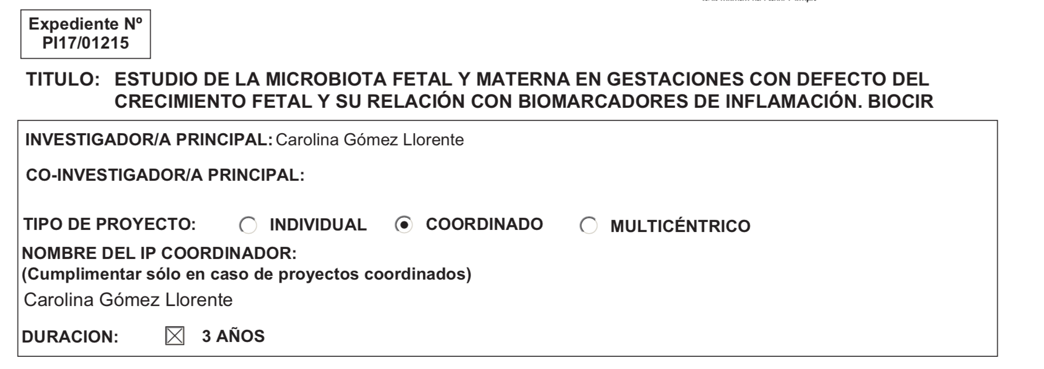
PROGRAMA 2
Programación materna y fetal de las enfermedades cardiovasculares y metabolicas de origen placentario.
OBJETIVO 1:
Nuevos marcadores placentarios PE/CIR
TO STUDY NOVEL PLACENTAL BIOMARKERS IN THE DIAGNOSIS AND PROGNOSIS OF PREECLAMPSIA (PE). (MAX VENTO)
REVIEW Microbiota (D. Mesa)

Slide 6
PROGRAMA 2
Programación materna y fetal de las enfermedades cardiovasculares y metabolicas de origen placentario.
TO DETERMINE THE USEFULNESS OF NOVEL PLACENTAL BIOMARKERS (sFlt1/PlGF ratio) IN THE DIAGNOSIS AND PROGNOSIS OF PREECLAMPSIA (ELISA LLURBA).
To demonstrate that the use of sFlt1/PlGF ratio for the diagnosis and classification of PE improve maternal and neonatal outcome.
b) To collect evidence that the use of sFlt-1/PlGF ratio decreases hospital stay compared to the classical definition.
c) To elaborate a clinical score for maternal-neonatal prognosis combining prenatal maternal and fetal biomarkers.
d) To establish updated guidelines and protocols for the diagnosis, classification and management of PE with the use of the sFlt1/PlGF ratio.
e) To store biological samples from mother, umbilical cord, neonates and children in an ad hoc section of the Biobanks of the participating
groups to be used for WP1 and WP3.
OBJETIVO 2:
Predicción-prevención PE/CIR
  PI16

Slide 7
PROGRAMA 2
Programación materna y fetal de las enfermedades cardiovasculares y metabolicas de origen placentario.
TO DETERMINE THE USEFULNESS OF NOVEL PLACENTAL BIOMARKERS (sFlt1/PlGF ratio) IN THE DIAGNOSIS AND PROGNOSIS OF PREECLAMPSIA.
Update on the Diagnosis and Prognosis of Preeclampsia with the Aid of the sFlt-1/ PlGF Ratio in Singleton Pregnancies. Herraiz I, Llurba E, Verlohren S, Galindo A; Spanish Group for the Study of Angiogenic Markers in Preeclampsia. Fetal Diagn Ther. 2017 Jul 19. doi: 10.1159/000477903. [Epub ahead of print] PMID: 28719896
Zeisler H, Llurba E, Chantraine FJ, Vatish M, Staff AC, Sennström M, Olovsson M, Brennecke SP, Stepan H, Allegranza D, Schoedl M, Grill S, Hund M, Verlohren S. Soluble fms-like tyrosine kinase-1 to placental growth factor ratio: ruling out pre-eclampsia for up to 4 weeks and value of retesting. Ultrasound Obstet Gynecol. 2019 Mar;53(3):367-375. doi: 10.1002/uog.19178. Epub 2019 Feb 4. PMID: 3001456
Tumor Necrosis Factor-Alpha and Pregnancy: Focus on Biologics. An Updated and Comprehensive Review. Alijotas-Reig J, Esteve-Valverde E, Ferrer-Oliveras R, Llurba E, Gris JM. Clin Rev Allergy Immunol. 2017 Jan 4. doi: 10.1007/s12016-016-8596-x. [Epub ahead of print] Review. PMID: 28054230
OBJETIVO 2:
Predicción-prevención PE/CIR
  PI16

Slide 8
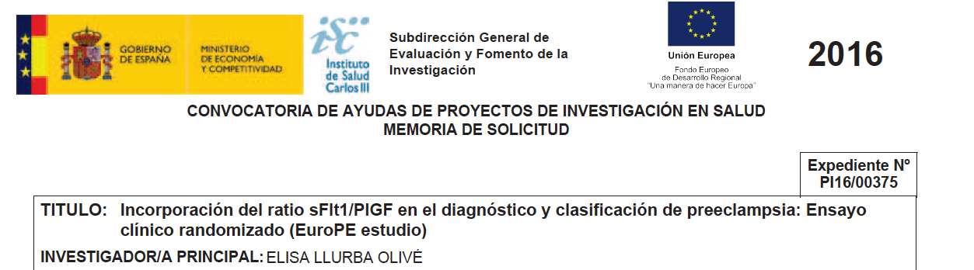
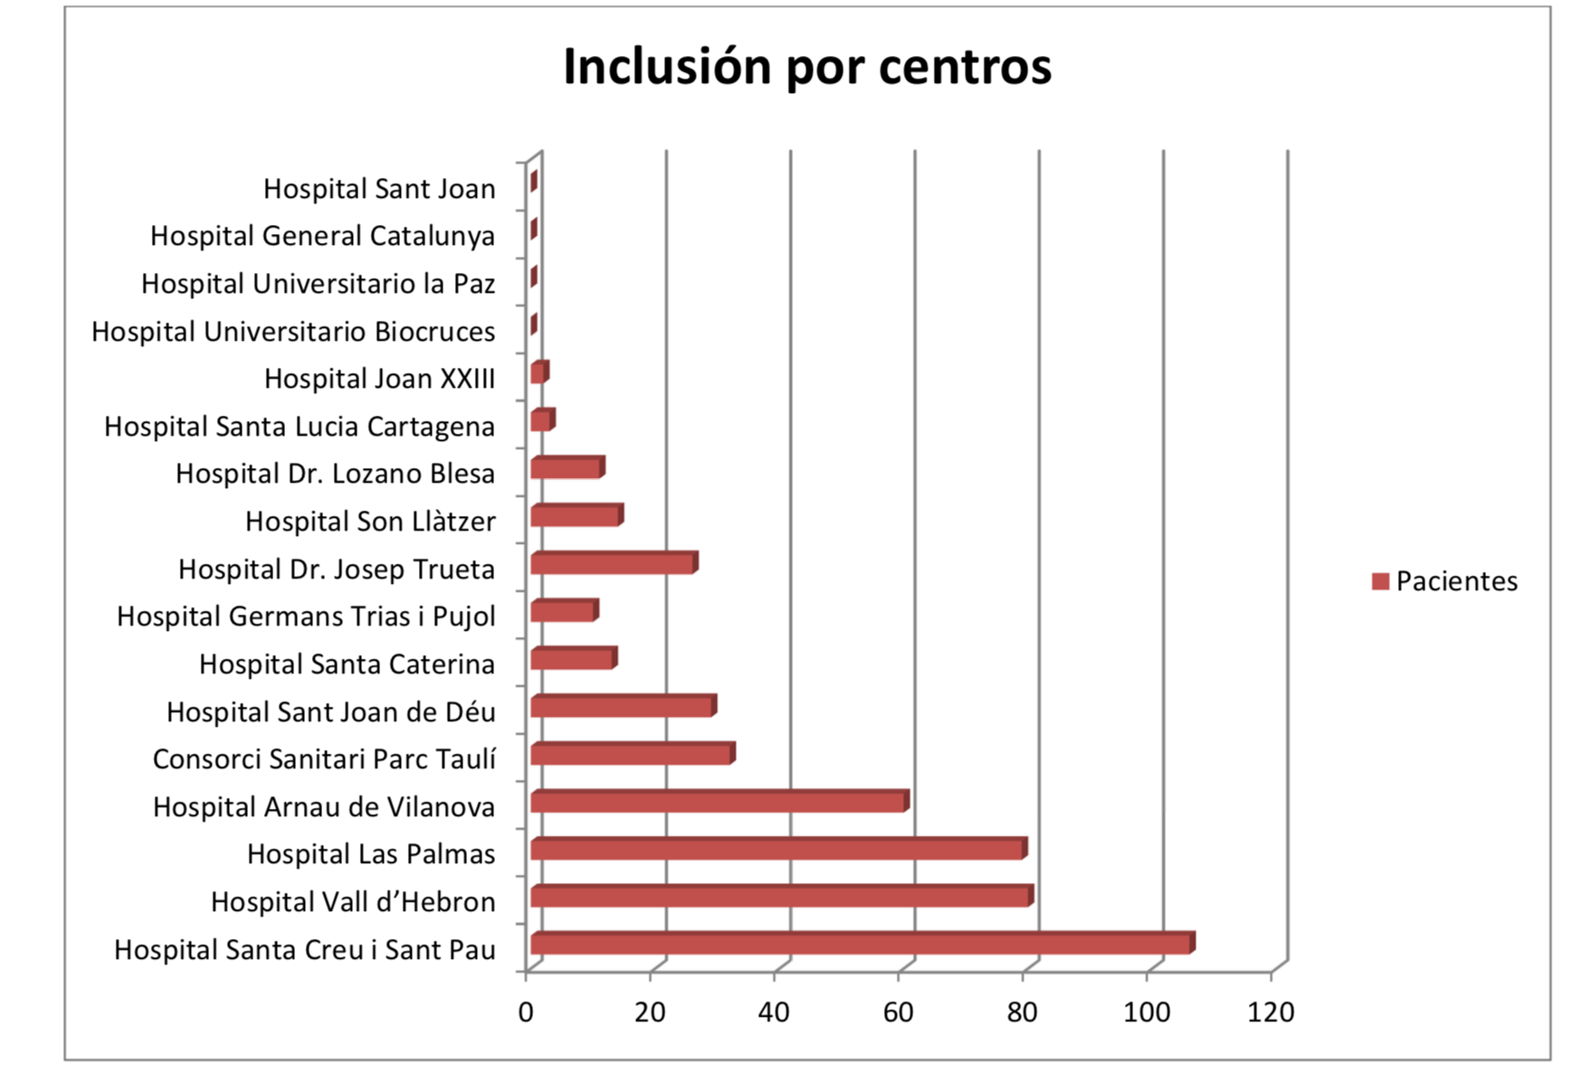

Slide 9
PROGRAMA 2
Programación materna y fetal de las enfermedades cardiovasculares y metabolicas de origen placentario.
OBJECTIVE 3.
TO STUDY NOVEL MATERNAL AND CHILDREN CARDIOVASCULAR RISK BIOMARKERS AND TO EXPLORE POTENTIAL PREVENTIVE STRATEGIES (RODRIGUEZ MARTINEZ)
a) To correlate severity of PE/IUGR with cardiovascular dysfunction parameters in mothers and fetuses and its relation with anti-angiogenic
factors (sFlt1, sEng).
Fis 2016-PI J. Alijotas pendiente resultados/BIOCIR/ensayo Tracip
b) To evaluate the relationship between placental biomarkers during pregnancy and the incidence of cardiovascular injury at medium-long term
in women who had had PE or intrauterine growth retardation (IUGR).
Fis 2016-PI J. Alijotas pendiente resultados/BIOCIR/ensayo Tracip
c) To create and validate an animal model to study the extent of the impact of placental insufficiency in cardiovascular targets.
Fis 2016-PI J. Alijotas pendiente resultados
d) To study the application of potential preventive measures (exercise, diet and aspirin) after childbirth to improve cardiovascular future
maternal and offspring health.
Basándonos en una muestra representativa de niños aragoneses (estudio CALINA, 1600 niños), explorar los determinantes del periodo perinatal y de la infancia temprana del sobrepeso y la obesidad, y su mediación en el riesgo cardiovascular.
OBJETIVO 3:
Risc CV tardío
  PI16-col

Slide 10
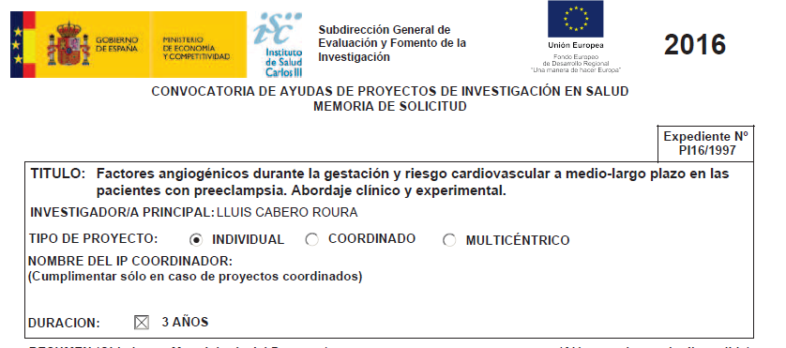

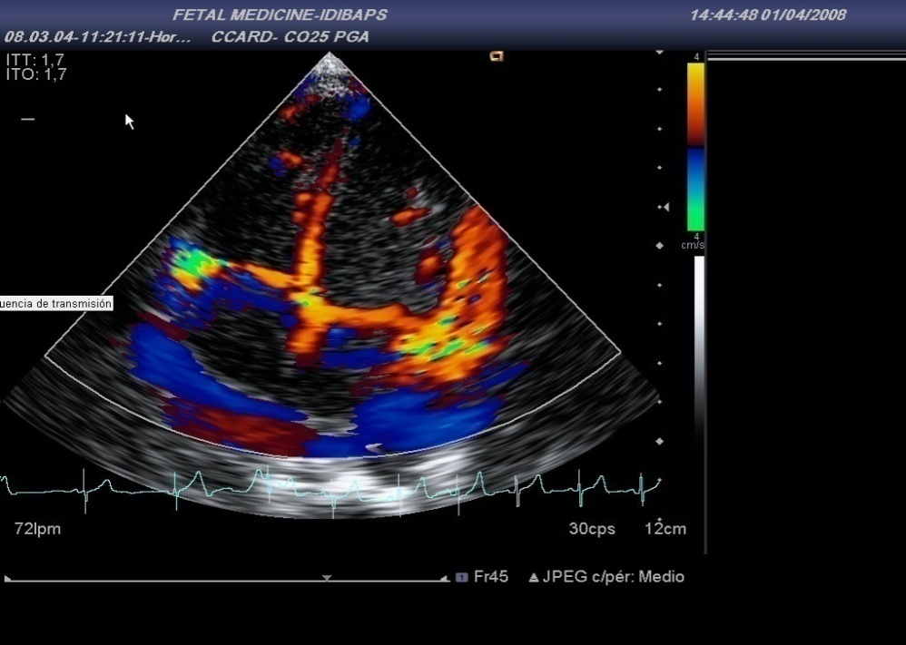


Study design:
n= 46
severe early-onset PE +/-IUGR at 24.0-32.6 w
sFlt-1/plGF at admission delivery (2006-2010)
11-7 years later

Slide 11
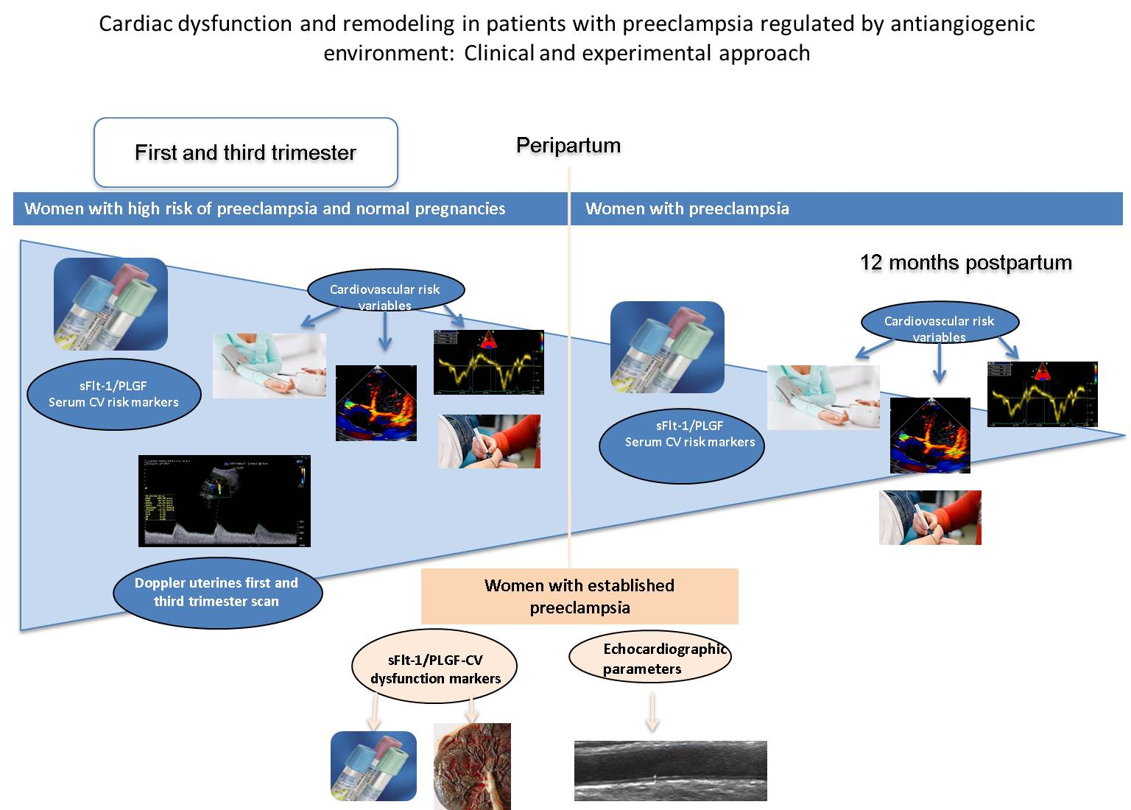
PROGRAMA 2
Programación materna y fetal de las enfermedades cardiovasculares y metabolicas de origen placentario.
OBJETIVO 3:
Risc CV tardío
  PI19-col

Slide 12
PROGRAMA 2
Programación materna y fetal de las enfermedades cardiovasculares y metabolicas de origen placentario.
OBJECTIVE 4
TO STUDY PRENATAL AND POSTNATAL FACTORS INVOLVED IN THE ETIOLOGY OF ADVERSE NEUROLOGIC OUTCOME IN
CHILDREN WITH CONGENITAL HEART DISEASE. F. CABAÑAS
To describe the neurodevelopment outcome of patients with complex CHD at 24 months of age and identify a subgroup with poorer outcome
b) To evaluate the utility of fetal and postnatal (preoperative and postoperative) diagnostic techniques for early recognition of patients at risk for altered neurologic outcome
c) To develop and validate predictive algorithms of poor later neurodevelopment in CHD patients
OBJETIVO 4:
Cardiopatias cong
PI13/01449
NIH 2017

Slide 13
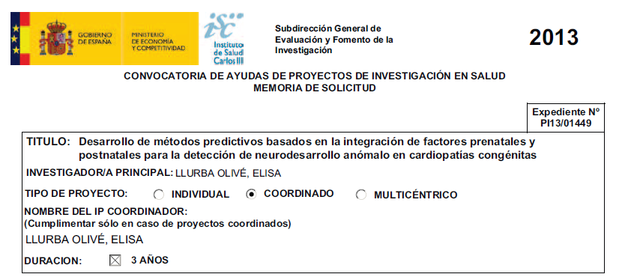
HU la Paz de Madrid
H Sant Joan de Dèu de Barcelona
Hospital Universitario 12 de Octubre
H Universitari Vall d’Hebron de Barcelona

Slide 14
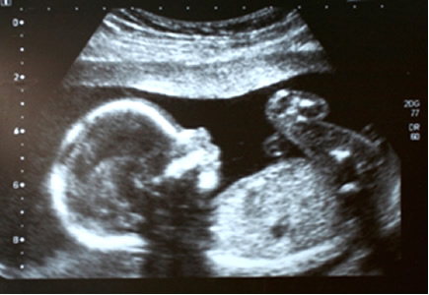
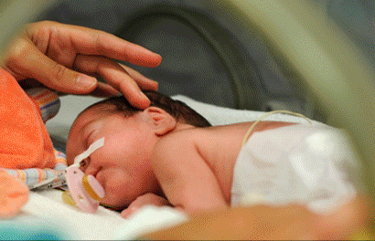
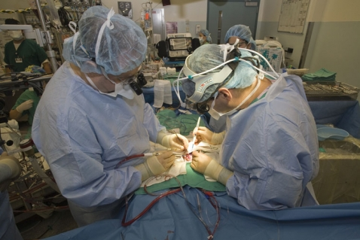
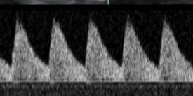
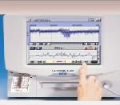
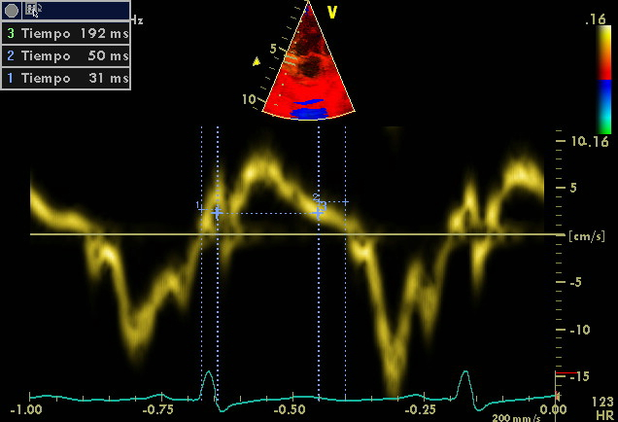
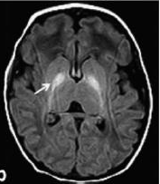

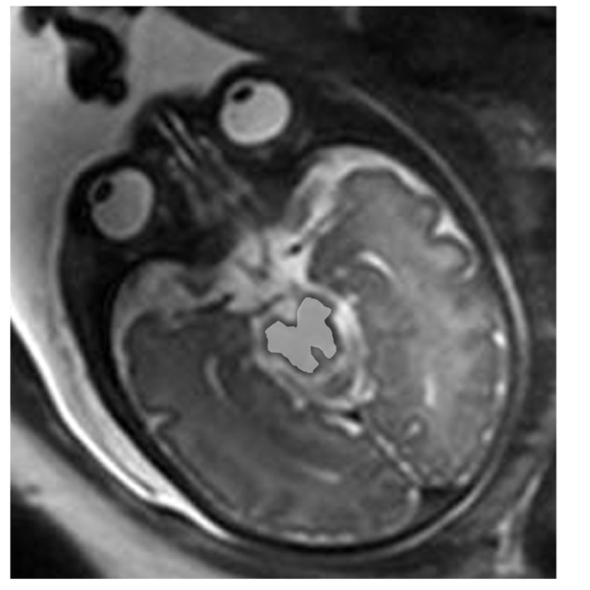
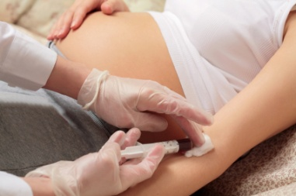
PI13/01449
Desarrollo de métodos predictivos basados en la integración de factores prenatales y postnatales para la detección de neurodesarrollo anómalo en cardiopatías congénitas
Prenatal
Pre-surgery
Post-surgery
Abnormal prenatal MR
Brain vasodilatation
Microcefaly
Hypotermia
Circulatory arrest
Cardiopulmonary bypass
Alterations in cerebral blood flow
~50%
~30-50%
~40%
Abnormal neurobehavioral
Abnormal brain MRM and Ultrasound
HU 12 Octubre, HU La Paz, HU La Fe Valencia, Inst. U Dexeus, H Clínic-Maternitat-HSJD, HUVH

Slide 15

PROGRAMA 2
Programación materna y fetal de las enfermedades cardiovasculares y metabolicas de origen placentario.
TO STUDY PRE-NATAL ENVIRONMENT AND IT'S INFLUENCE ON PLACENTAL DYSFUNCTION AND FETAL HEART DEVELOPMENT AND CARDIOVASCULAR DISEASE LATER IN LIFE. (LOLA GÓMEZ-ROIG)
a) To assess the association between maternal and fetal biomarkers of placental dysfunction and exposure to air pollution compounds and
heavy metals (cadmium, mercury and lead) during pregnancy
b) To assess the association between heart function and structural outcomes and exposure to air pollution compounds and heavy metals
during pregnancy
c) To assess the association between placental vascular, inflammation and oxidative stress biomarkers and exposure to air pollution
compounds and heavy metals during pregnancy.
d) To create and validate an animal model to study the extent of the impact of air pollution compounds and heavy metals in cardiovascular
targets in maternal and offspring.
OBJETIVO 5
Ambiente y complicaciones cardiovasculares

Slide 16

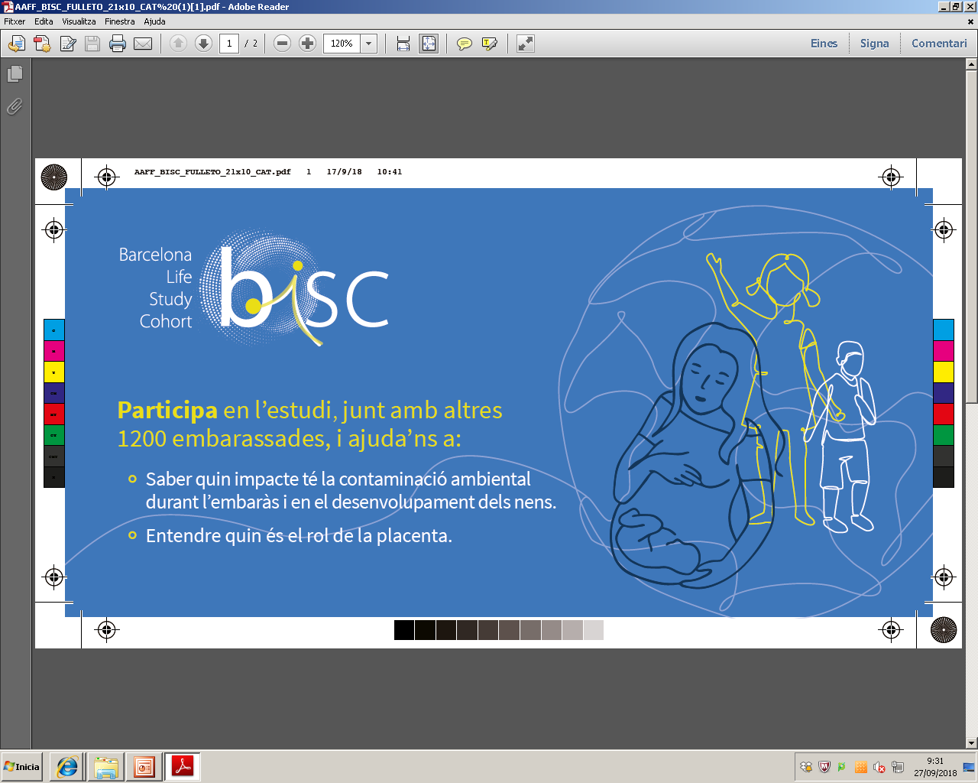

BiSC: Barcelona Life Study
Cohort
PROGRAMA 2
Programación materna y fetal de las enfermedades cardiovasculares y metabolicas de origen placentario.
OBJETIVO 5
Ambiente y complicaciones cardiovasculares

Slide 17

PROGRAMA 2
Programación materna y fetal de las enfermedades cardiovasculares y metabolicas de origen placentario.
OBJECTIVE 6. PRENATAL EXPOSURE TO ALCOHOL AND OTHER SUBSTANCES OF ABUSE AS AN ETIOLOGIC FACTOR OF POSTNATAL CARDIOVASCULAR DELETERIOUS EFFECTS. (ÓSCAR GARCÍA-ALGAR)
a)To assess the vascular placental deleterious effects of prenatal exposure to alcohol and other substances of abuse
b)To assess the association between placentalbiomarkers(vascular, inflammation and oxidative stress)and prenatal exposure
to alcohol and other substances of abuse
c)To follow up children prenatally exposed to alcohol about cardiovascular risk
d)To create and validate animals models in order to study prenatal exposure to alcohol and other substances of abuse as an etiologic factor of cardiovascular deleterious effects
OBJETIVO 5
Tóxicos y complicaciones cardiovasculares

